Slide 1
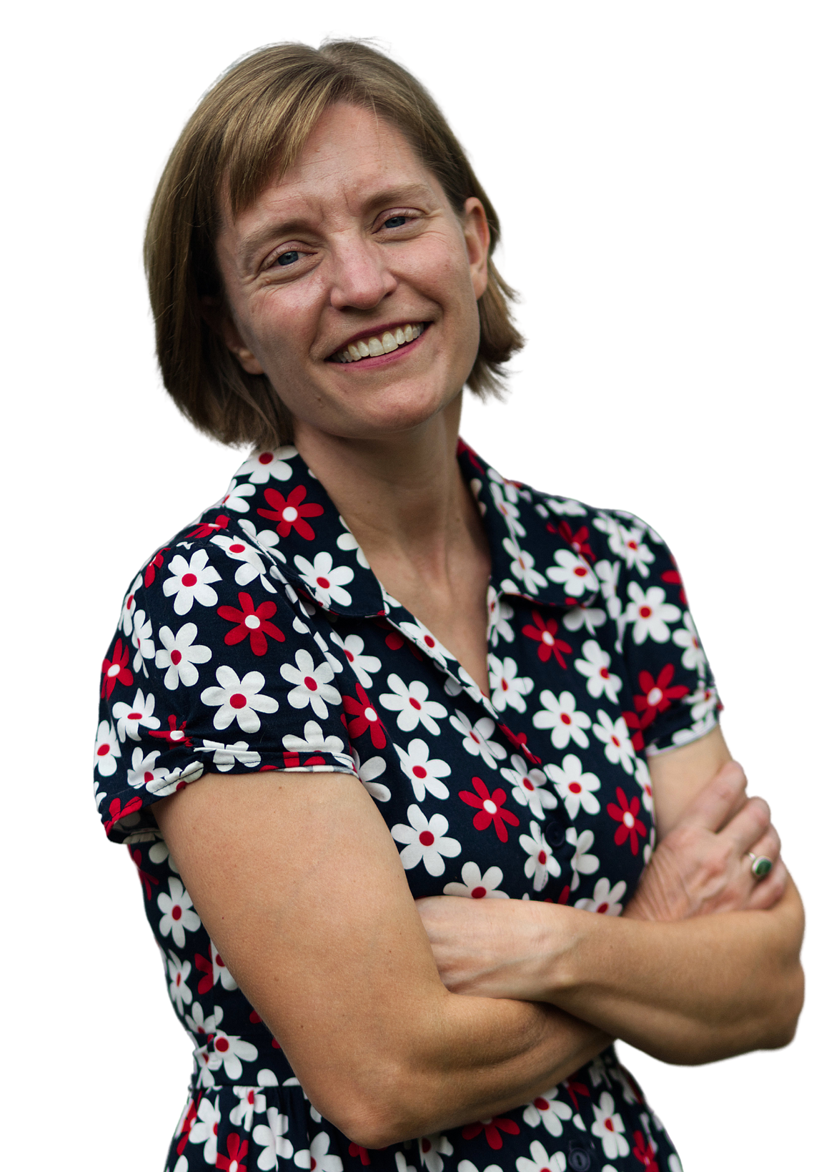
Building a Bridge to Abundant Social Change
MMI Grantee Renewal Conference
September 26, 2022

Slide 2
What don’t you have enough of?
What do you lack?

Slide 3
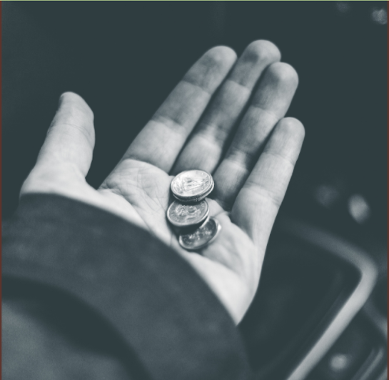
What is Scarcity Thinking?
The belief that there is not, and never will be, enough

Slide 4
There are not enough...
Dollars
Board members
Funders/Donors
Partners
Government contracts
Volunteers
Helpful laws/policies

Slide 5
You don’t have enough of that….YET

Slide 6
A Scarcity Mindset = a nearly constant belief that there is not enough

Slide 7
What is Scarcity Thinking…
in your staff?
“There just aren’t enough donors out there.”
“Board members are really hard to find.”
“The economy (pandemic, latest crisis) makes it really hard to fundraise (deliver programs, do my job)”

Slide 8
What is Scarcity Thinking…
in your board?
“I don’t know anyone with money.”
“I don’t have enough knowledge (expertise, networks) to help you.”
“The economy (pandemic, latest crisis) makes it really hard to achieve our mission”

Slide 9
What is Scarcity Thinking…
in your funders?
“There are too many nonprofits out there (or in this space).”
“Can’t you combine efforts with others since there is limited funding?”
“These problems are overwhelming.”
“I can’t change my board.”
“I can’t convince other funders to join me in this.”

Slide 10
What is Scarcity Thinking…
in yourself?
“I never have enough time to get it all done.”
“It’s all up to me.”
“I don’t know what I’m doing.”
“I’m exhausted.”
“This is really hard.”

Slide 13
Any Scarcity Thought is Just Fear in Disguise

Slide 14
Scarcity Thought | Underlying Fear
“We don’t have enough money” | We will run out of money and go broke
“We don’t have enough helpful board members” | This is all up to me, I’m all alone
“I don’t have enough expertise/knowledge” | I’m a failure or a fake and everyone will find out
“We don’t have enough connections to funders” | We are irrelevant and all alone

Slide 15
Scarcity Thought | Underlying Fear
“We don’t have enough money” | We will run out of money and go broke
“We don’t have enough helpful board members” | This is all up to me, I’m all alone
“I don’t have enough expertise/knowledge” | I’m a failure or a fake and everyone will find out
“We don’t have enough connections to funders” | We are irrelevant and all alone

Slide 16
Scarcity Thought | Underlying Fear
“We don’t have enough money” | We will run out of money and go broke
“We don’t have enough helpful board members” | This is all up to me, I’m all alone
“I don’t have enough expertise/knowledge” | I’m a failure or a fake and everyone will find out
“We don’t have enough connections to funders” | We are irrelevant and all alone

Slide 17
Scarcity Thought | Underlying Fear
“We don’t have enough money” | We will run out of money and go broke
“We don’t have enough helpful board members” | This is all up to me, I’m all alone
“I don’t have enough expertise/knowledge” | I’m a failure or a fake and everyone will find out
“We don’t have enough connections to funders” | We are irrelevant and all alone

Slide 18
Scarcity Thought | Underlying Fear
“We don’t have enough money” | We will run out of money and go broke
“We don’t have enough helpful board members” | This is all up to me, I’m all alone
“I don’t have enough expertise/knowledge” | I’m a failure or a fake and everyone will find out
“We don’t have enough connections to funders” | We are irrelevant and all alone

Slide 19
Scarcity Thought | Underlying Fear
“We don’t have enough money” | We will run out of money and go broke
“We don’t have enough helpful board members” | This is all up to me, I’m all alone
“I don’t have enough expertise/knowledge” | I’m a failure or a fake and everyone will find out
“We don’t have enough connections to funders” | We are irrelevant and all alone

Slide 20
Scarcity Thought | Underlying Fear
“We don’t have enough money” | We will run out of money and go broke
“We don’t have enough helpful board members” | This is all up to me, I’m all alone
“I don’t have enough expertise/knowledge” | I’m a failure or a fake and everyone will find out
“We don’t have enough connections to funders” | We are irrelevant and all alone

Slide 21
Scarcity Thought | Underlying Fear
“We don’t have enough money” | We will run out of money and go broke
“We don’t have enough helpful board members” | This is all up to me, I’m all alone
“I don’t have enough expertise/knowledge” | I’m a failure or a fake and everyone will find out
“We don’t have enough connections to funders” | We are irrelevant and all alone

Slide 22
Every underlying fear can ultimately be reduced to
“I will die in the woods, naked and alone”

Slide 23
But the truth is...
You are surrounded by everything you need, you just have to let it in…

Slide 24
But the truth is...
You are surrounded by everything you need, you just have to let it in…

Slide 27
Take any “lack” and build a bridge

Slide 28
The Bridge of “Yet”
“I don’t know what I’m doing...Yet”
“I don’t have enough energy...Yet”
“My board is not helpful...Yet”
“There is not enough money...Yet”

Slide 29
Once You’ve Built your Bridge of Yet, you can head toward
The Land of Abundance

Slide 30
“We don’t have ”

Slide 31
“We don’t have ”
“We don’t have yet… but if we do X we can attract it.”

Slide 32
“We don’t have ”
“We don’t have yet… but if we do X we can attract it.”

Slide 33
Creating a Bridge to Abundance
We don't have enough money to achieve our goals... yet. But if we put together a smart money-raising plan, we will.
We don't have enough of the right people on our board... yet. But we can start brainstorming ideal candidates and then figure out how to connect with them.
We don't know how to fundraise effectively... yet. But if we start researching and asking experts for help, we can get much better at it.

Slide 34
Creating a Bridge to Abundance
We don't have enough money to achieve our goals... yet. But if we put together a smart money-raising plan, we will.
We don't have enough of the right people on our board... yet. But we can start brainstorming ideal candidates and then figure out how to connect with them.
We don't know how to fundraise effectively... yet. But if we start researching and asking experts for help, we can get much better at it.

Slide 35
Creating a Bridge to Abundance
We don't have enough money to achieve our goals... yet. But if we put together a smart money-raising plan, we will.
We don't have enough of the right people on our board... yet. But we can start brainstorming ideal candidates and then figure out how to connect with them.
We don't know how to fundraise effectively... yet. But if we start researching and asking experts for help, we can get much better at it.

Slide 36
Creating a Bridge to Abundance
We don't have enough money to achieve our goals... yet. But if we put together a smart money-raising plan, we will.
We don't have enough of the right people on our board... yet. But we can start brainstorming ideal candidates and then figure out how to connect with them.
We don't know how to fundraise effectively... yet. But if we start researching and asking experts for help, we can get much better at it.

Slide 37
Creating a Bridge to Abundance
We don't have enough money to achieve our goals... yet. But if we put together a smart money-raising plan, we will.
We don't have enough of the right people on our board... yet. But we can start brainstorming ideal candidates and then figure out how to connect with them.
We don't know how to fundraise effectively... yet. But if we start researching and asking experts for help, we can get much better at it.

Slide 38
Creating a Bridge to Abundance
We don't have enough money to achieve our goals... yet. But if we put together a smart money-raising plan, we will.
We don't have enough of the right people on our board... yet. But we can start brainstorming ideal candidates and then figure out how to connect with them.
We don't know how to fundraise effectively... yet. But if we start researching and asking experts for help, we can get much better at it.

Slide 39
Creating a Bridge to Abundance
We don't have enough money to achieve our goals... yet. But if we put together a smart money-raising plan, we will.
We don't have enough of the right people on our board... yet. But we can start brainstorming ideal candidates and then figure out how to connect with them.
We don't know how to fundraise effectively... yet. But if we start researching and asking experts for help, we can get much better at it.

Slide 40
Creating a Bridge to Abundance
We don't have access to the policy influencers necessary to move our mission forward... yet. But if we create a list of the key policymakers passionate about our issue, then we can figure out who in our network might be able to introduce us.

Slide 41
Creating a Bridge to Abundance
We don't have access to the policy influencers necessary to move our mission forward... yet. But if we create a list of the key policymakers passionate about our issue, then we can figure out who in our network might be able to introduce us.
Your Turn!

Slide 44
To truly attract abundance, you must articulate how you
will use it

Slide 45
What do you ultimately want your organization to achieve?

Slide 46
Theory of Change
Describes the social change you seek

Slide 47
Theory of Change
Target Population
Short/Long Term Outcomes
External Context
Activities
Assumptions
What people or groups are you seeking to benefit or influence?
What relevant trends in or changes to the external environment are occuring?
How and where are you core competencies employed?
What changed conditions do you believe will result from these activities?
What evidence do you have that this theory will actually result in change?

Slide 48
Theory of Change
Target Population
Short/Long Term Outcomes
External Context
Activities
Assumptions
What people or groups are you seeking to benefit or influence?
What relevant things are happening with your collaborators, competitors, clients & others?
How and where are you core competencies employed?
What changed conditions do you believe will result from these activities?
What evidence do you have that this theory will actually result in change?

Slide 49
Theory of Change
Target Population
Short/Long Term Outcomes
External Context
Activities
Assumptions
What people or groups are you seeking to benefit or influence?
What relevant things are happening with your collaborators, competitors, clients & others?
What is the core work you do?
What changed conditions do you believe will result from these activities?
What evidence do you have that this theory will actually result in change?

Slide 50
Theory of Change
Target Population
Short/Long Term Outcomes
External Context
Activities
Assumptions
What people or groups are you seeking to benefit or influence?
What relevant things are happening with your collaborators, competitors, clients & others?
What is the core work you do?
What changed conditions do you believe will result from these activities?
What evidence do you have that this theory will actually result in change?

Slide 51
Theory of Change
Target Population
Short/Long Term Outcomes
External Context
Activities
Assumptions
What people or groups are you seeking to benefit or influence?
What relevant things are happening with your collaborators, competitors, clients & others?
What is the core work you do?
What changed conditions do you believe will result from these activities?
What evidence do you have that this theory will actually result in change?

Slide 52
Theory of Change
Target Population
Short/Long Term Outcomes
External Context
Activities
Assumptions
What people or groups are you seeking to benefit or influence?
What relevant things are happening with your collaborators, competitors, clients & others?
What is the core work you do?
What changed conditions do you believe will result from these activities?
What evidence do you have that this theory will actually result in change?

Slide 53
Theory of Change
Target Population
Short/Long Term Outcomes
External Context
Activities
Assumptions
What people or groups are you seeking to benefit or influence?
What relevant things are happening with your collaborators, competitors, clients & others?
What is the core work you do?
What changed conditions do you believe will result from these activities?
What evidence do you have that this theory will actually result in change?
This becomes your Vision

Slide 54
Theory of Change
Target Population
Short/Long Term Outcomes
External Context
Activities
Assumptions
What people or groups are you seeking to benefit or influence?
What relevant things are happening with your collaborators, competitors, clients & others?
What is the core work you do?
What changed conditions do you believe will result from these activities?
What evidence do you have that this theory will actually result in change?
This becomes your Mission

Slide 55
Vision: The social change you seek (What you Want)
Mission: The work you do, and with whom, to move toward your Vision

Slide 56
Vision: The social change you seek (What you Want)
Mission: The work you do, and with whom, to move toward your Vision

Slide 57
Never forget:
You are offering your board, funders, staff & partners an incredible opportunity to invest (their time, talent, treasure) in a rockstar solution to a problem
they care deeply about.

Slide 58
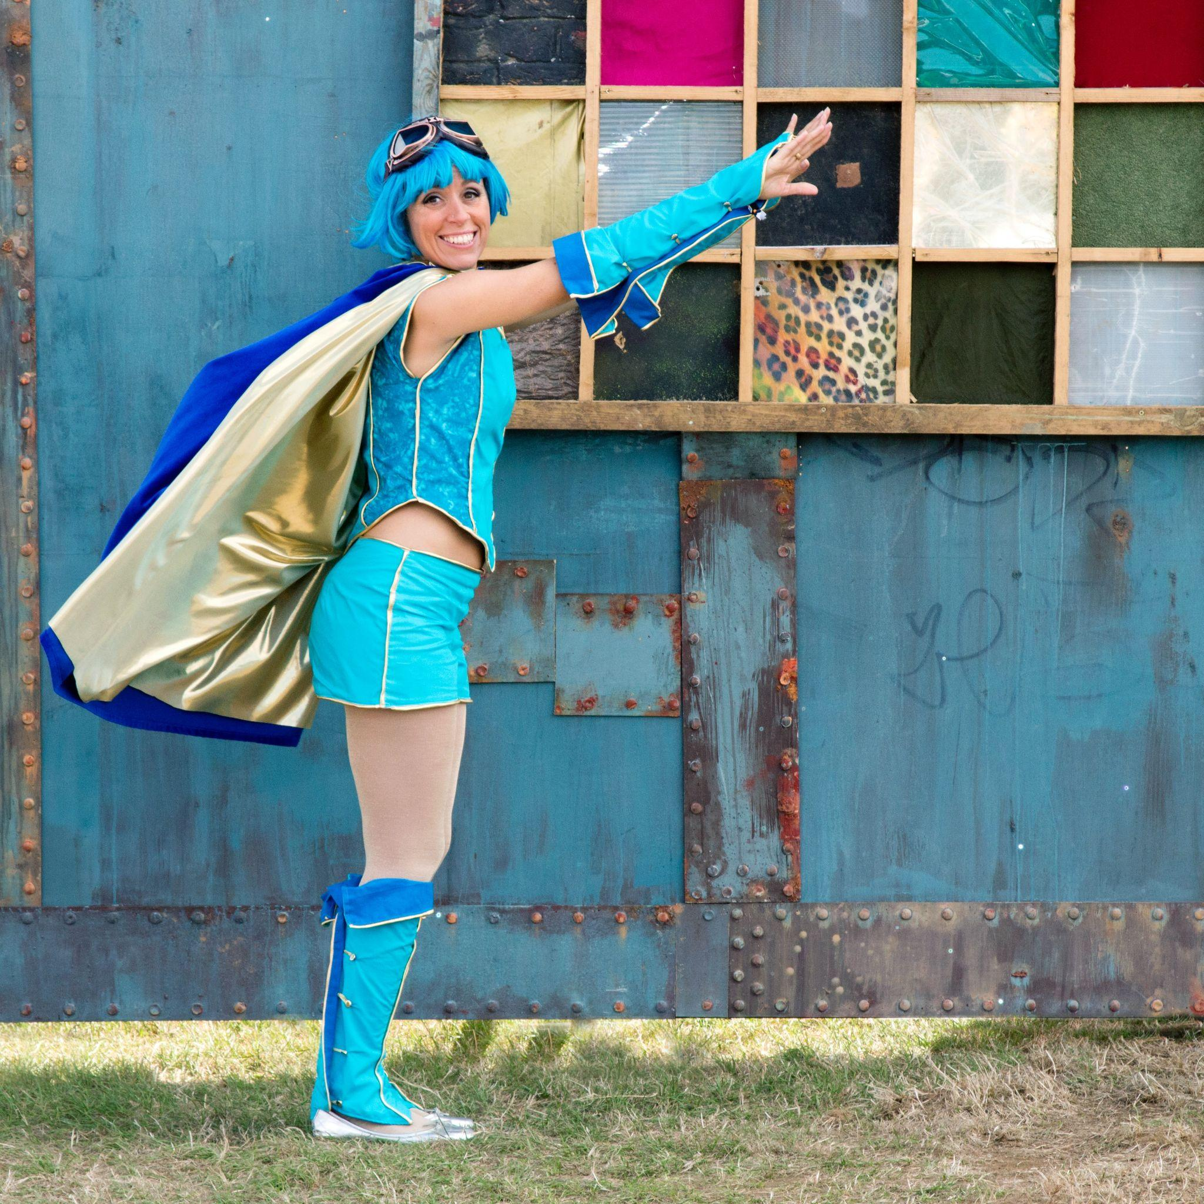
“Empaths are the ones most likely to bring balance to the disparity that currently exists. It’s critical for us to dig deep, and find the courage to step into our own power.”
— Anita Moorjani

Slide 59
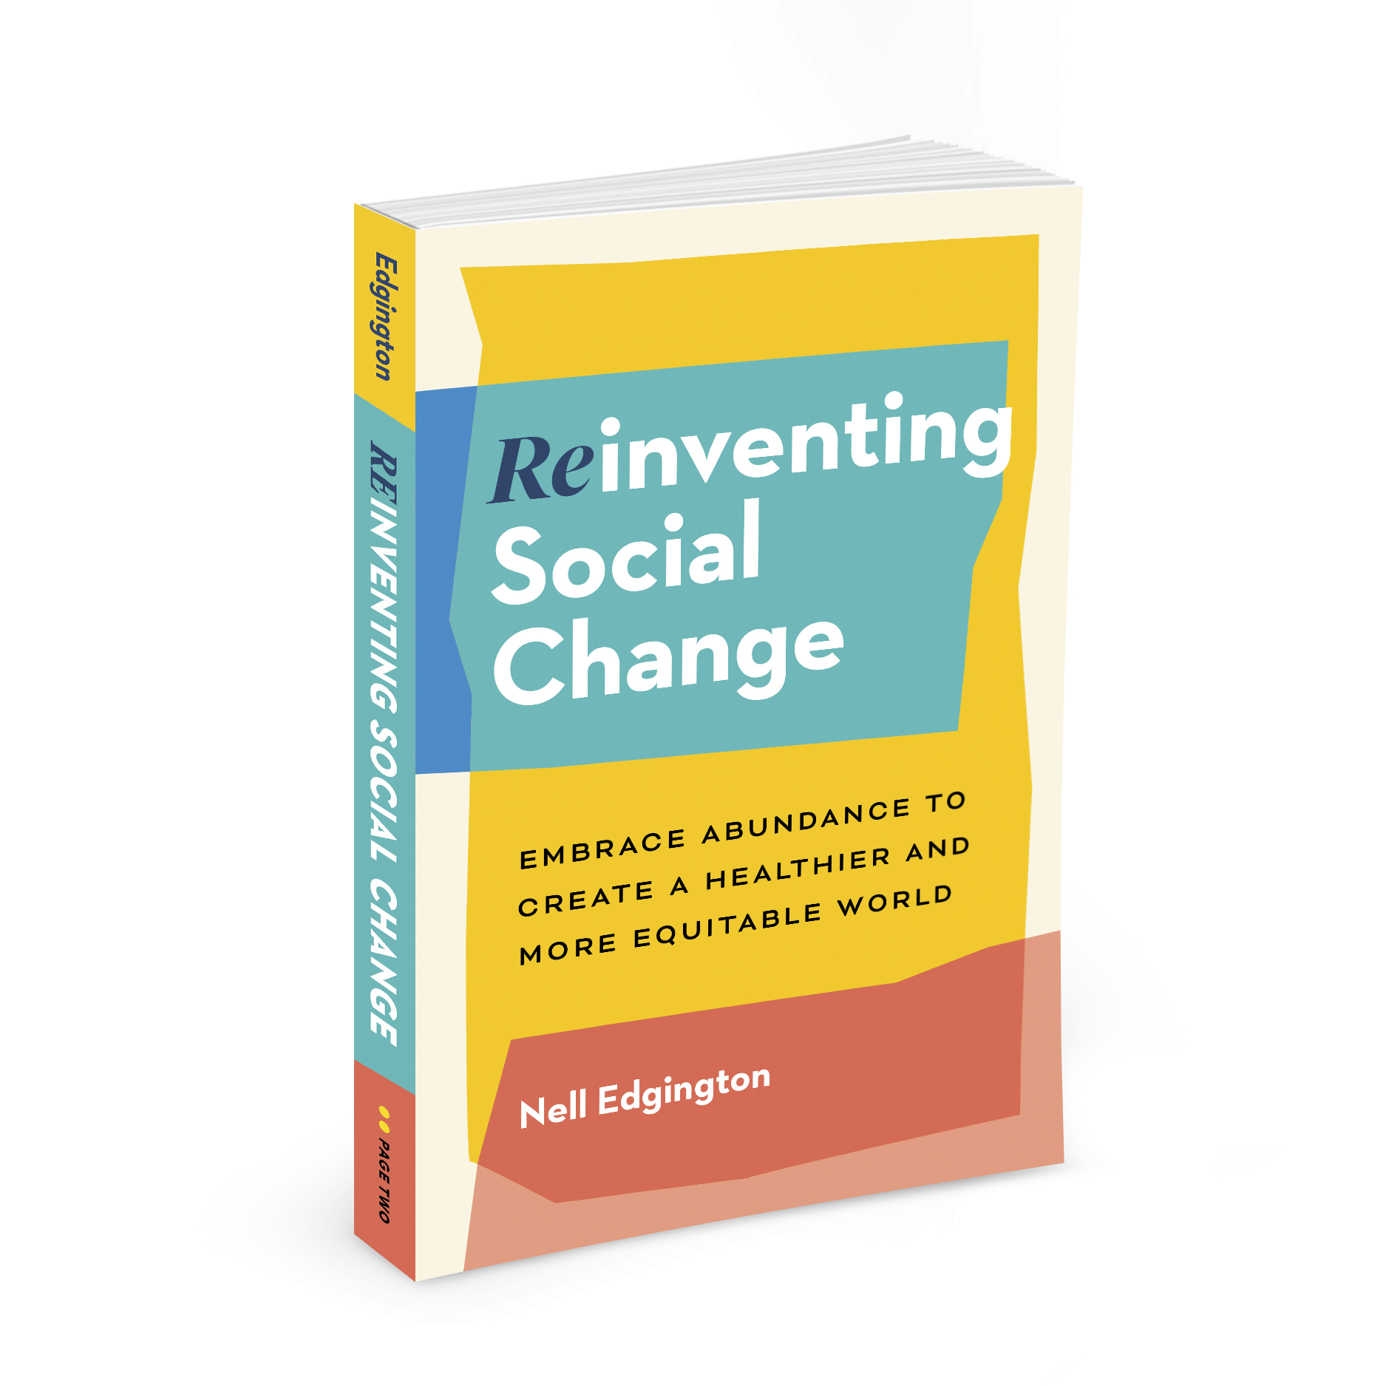
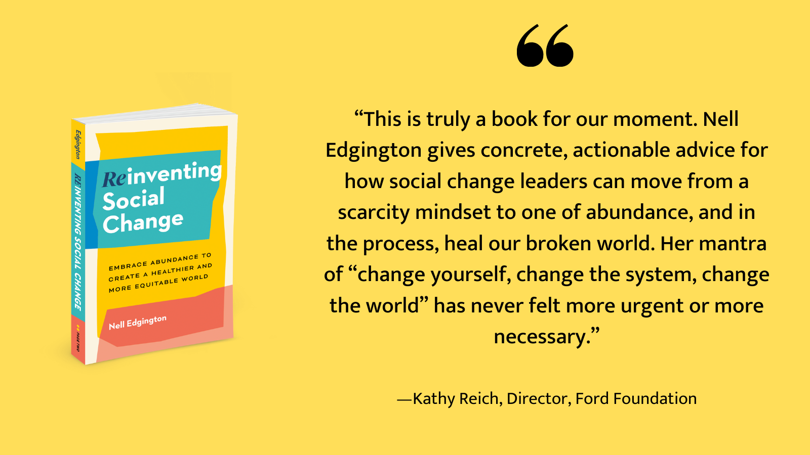
Grab Your Copy!
Paperback, e-book, and audiobooks are available anywhere books are sold

Slide 60
Theory of Change
Target Population
Short/Long Term Outcomes
External Context
Activities
Assumptions
What people or groups are you seeking to benefit or influence?
What relevant things are happening with your collaborators, competitors, clients & others?
What is the core work you do?
What changed conditions do you believe will result from these activities?
What evidence do you have that this theory will actually result in change?

